Slide 1
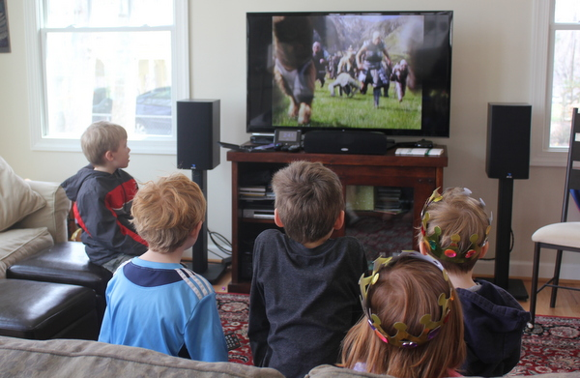
GLIMPSE

Slide 2
OF BACHELOR OF ENGINEERING IN INFORMATION TECHNOLOGY By
Shubham Rathod
Sarojini Patil
Onkar Supal
Tarannum Mulla
Kiran Powar
Under The Guidance of
Prof. S. S. Rabade
Department of Information Technology
KIT’s College of Engineering, Kolhapur

Slide 3
Outline
Problem Statement
Introduction
Purpose, Scope & Objective
Modules
Conclusion
References

Slide 4
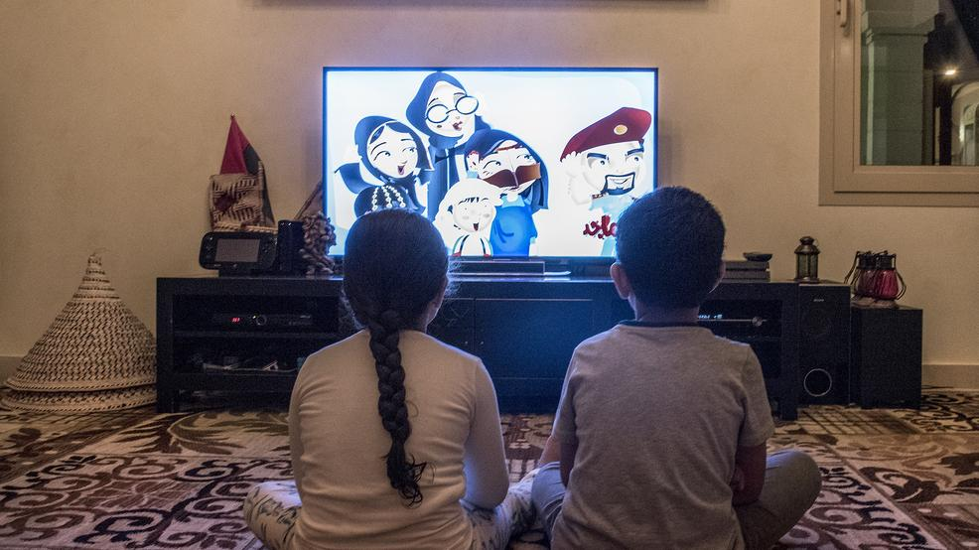
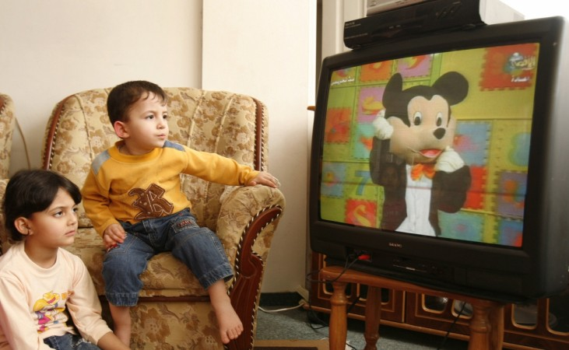
Introduction

Slide 5
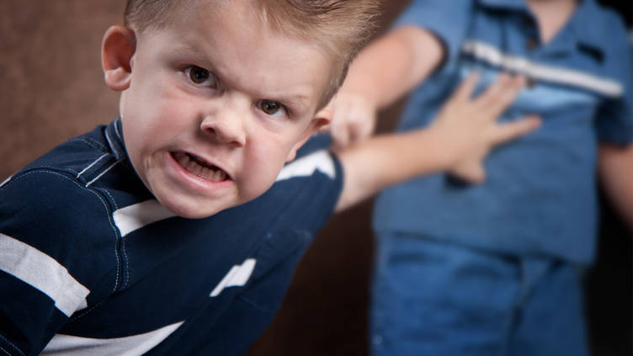
Problem Statement
Seeing violence
Adverse effect on health.
Risky and Aggressive behaviour.
Understanding Commercials

Slide 6
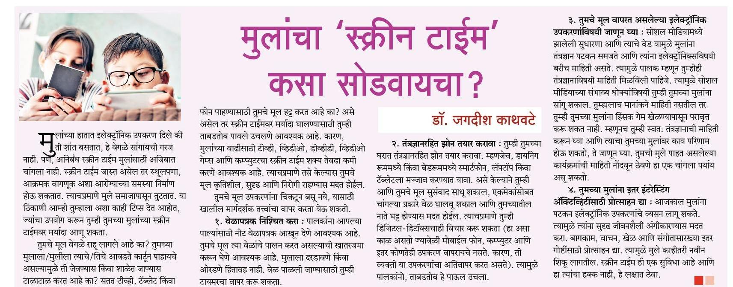
Problem Statement

Slide 7
Purpose, Scope & Objective
Purpose
Scope
Objective
To decrease the screen time of children of watching TV
To provide an efficient system to track children
To limit the children from watching TV
To have analytical control over the media that children watch
To track the actual TV watch time by the children
To monitor activities done by the children

Slide 8
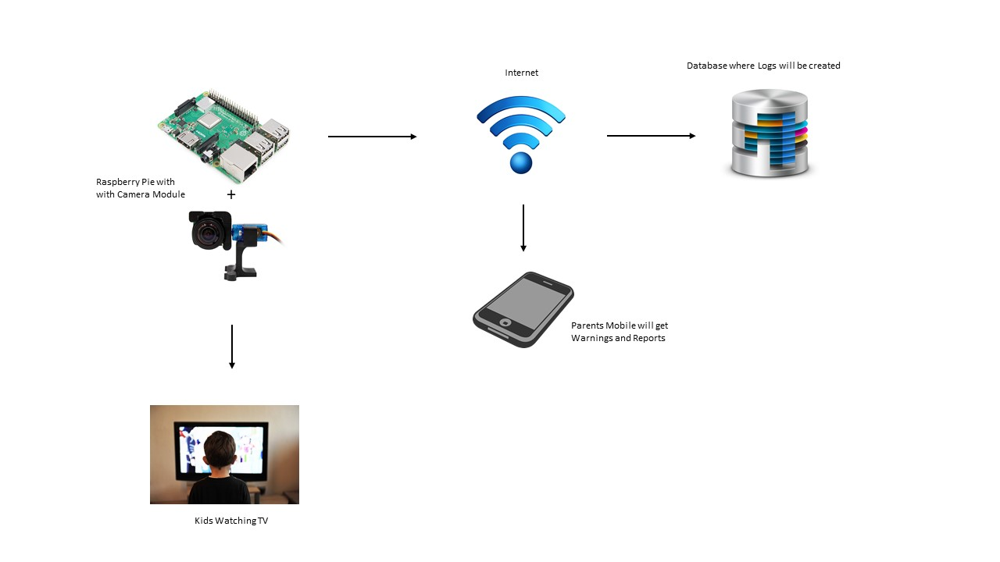
System Architecture

Slide 9
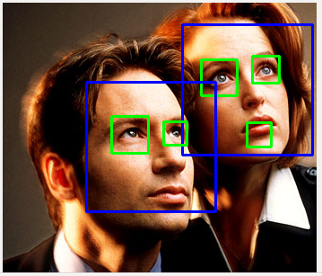
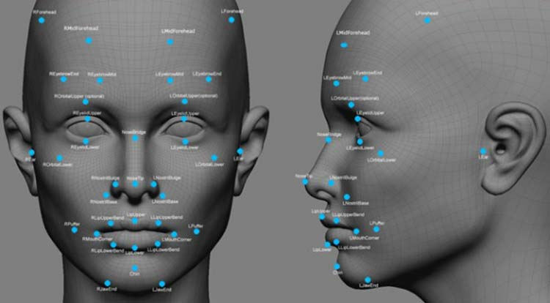
Modules
Face Detection and Identification Using Machine Learning
1. Haar Cascades Algorithm 2. Viola Jones Algorithm

Slide 10

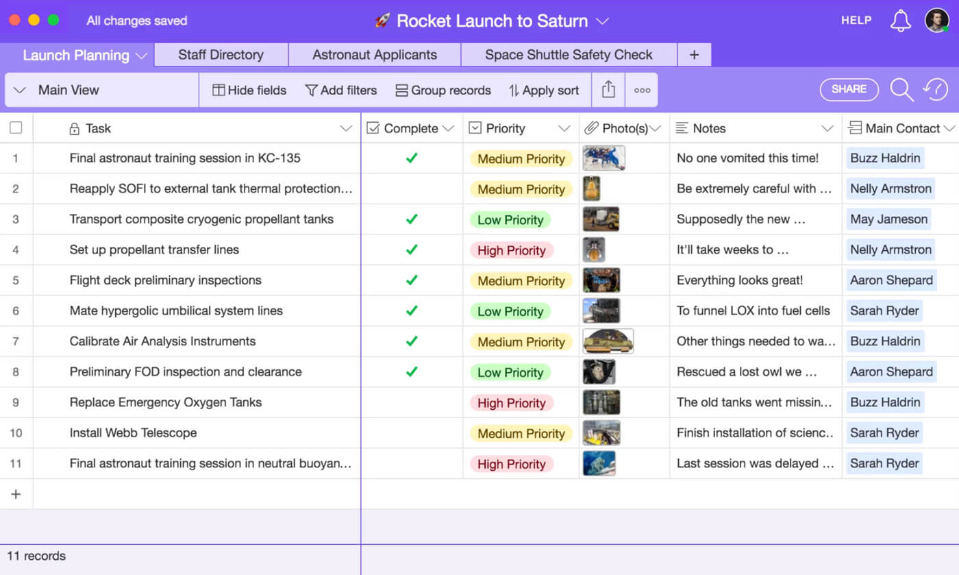
Modules
Maintaining Database

Slide 11


Modules
Alert and Warning System

Slide 12
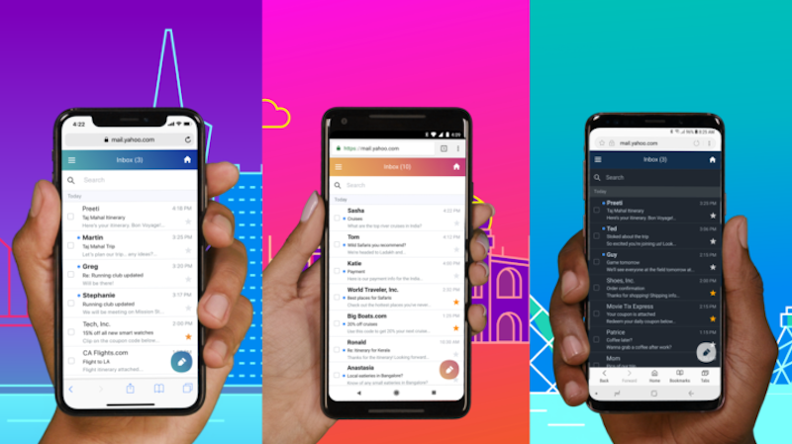
Modules
User Interface for Parents

Slide 13

Conclusion
The actual TV watch time of children will be decreased by using this system.
The parents will have the control over their children.
The proposed System is efficient to handle exceptions.

Slide 14
References
A Paper on “Face Detection System Based on Viola - Jones Algorithm” by Mehul K Dabhi , Bhavna K Pancholi
https://pdfs.semanticscholar.org/f63c/fcdd63bd34bcd6ec028169e6fe144e9cc83c.pdf
A Paper on “Human face detection algorithm via Haar cascade classifier combined with three additional classifiers” by Li Cuimei, Qi Zhiliang, Jia Nan and Wu Jianhua.
https://ieeexplore.ieee.org/abstract/document/8265863
A Paper on “Application of deep learning in object detection” by Xinyi Zhou, Wei Gong, WenLong Fu and Fengtong Du.
https://ieeexplore.ieee.org/document/7960069

Slide 15


